Slide 1

DATABASE MANAGEMENT SYSTEM COURSE PROJECT
Team No-4A17
DESIGN PHASE

Slide 2

APPLIANCE STORE MANAGEMENT SYSTEM
Team No-4A17
TEAM MEMBERS:
Anusha Raikar 01FE18BCS043
Apoorva Jinde 01FE18BCS044
Archana Badagi 01FE18BCS045
Ashwini Banagar 01FE18BCS054
Team Leader: Apoorva Jinde

Slide 3

ROLE OF TEAM MEMBERS
Responsibilities:
Anusha Raikar:
Tables’ creation, insertion of values and Normalization
Apoorva Jinde:
GUI implementation and Normalization
Archana Badagi:
Data collection and Normalized Schema
Ashwini Banagar:
Normalized schema and ppt.

Slide 4
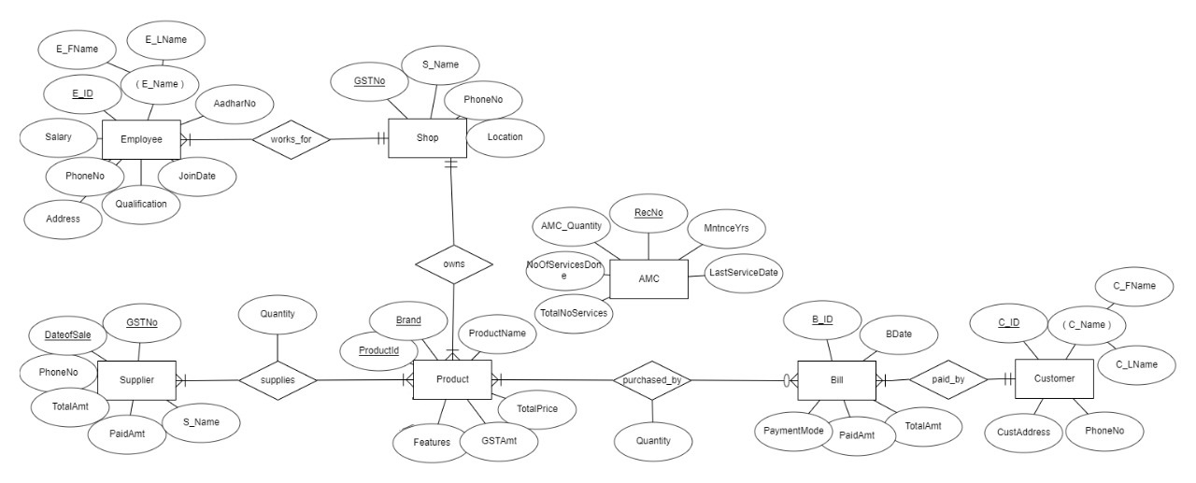
ER DIAGRAM

Slide 5
NORMALISATION
Entities:
Employee, Shop, Supplies, Product, Purchased_by, AMC,Bill,Customer
The above entities have all its attributes as single or atomic values hence we conclude that the following relation is in 1NF
For the schemas to be in 2NF there need to have partial dependencies of the attributes on the composite primary key.But we do not have any such cases . Hence there is no further decomposition.
Therefore the above entities are in 1NF.

Slide 6
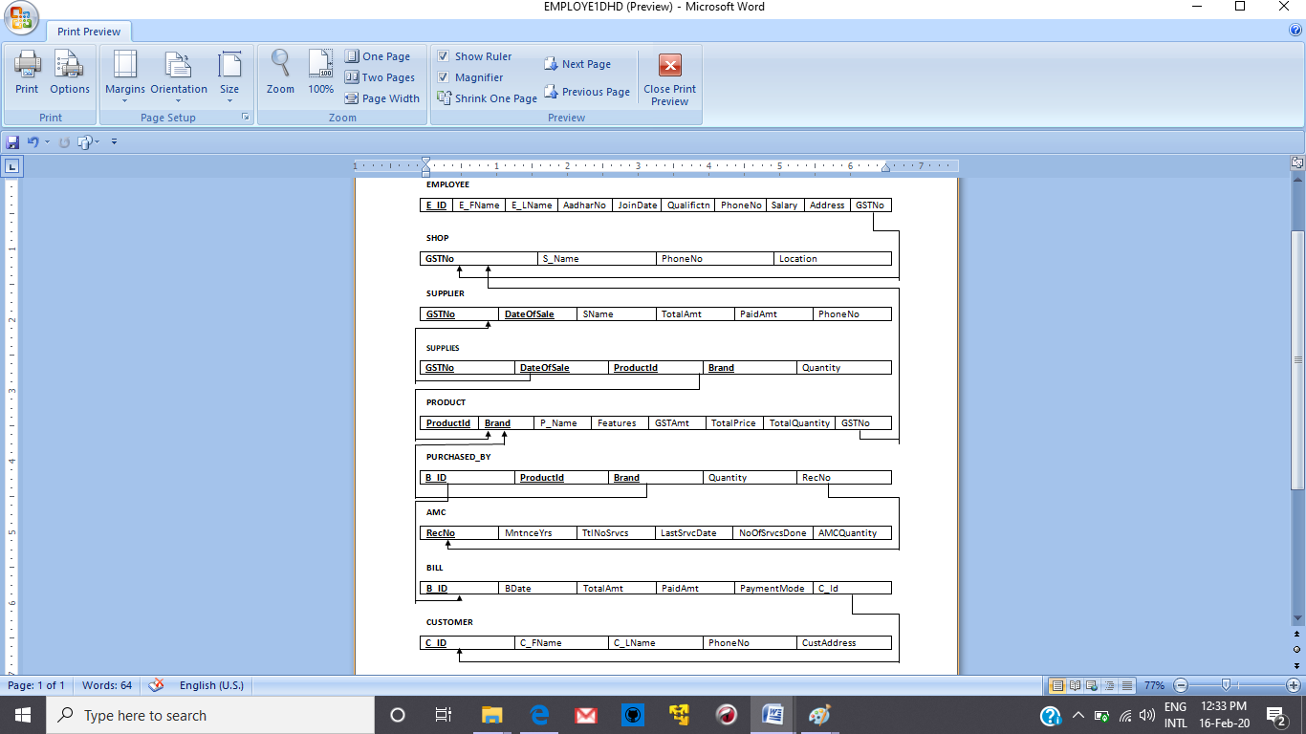
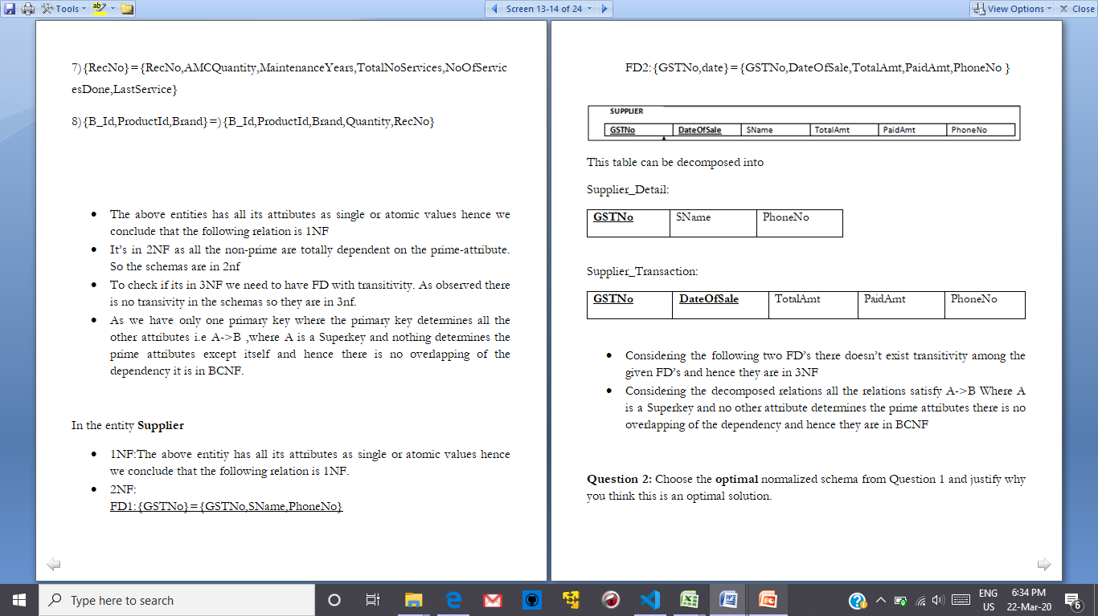
In the entity Supplier
1NF:The above entitiy has all its attributes as single or atomic values hence we conclude that the following relation is 1NF.
2NF:-FD1:{GSTNo}={GSTNo,SName,PhoneNo}
FD2:{GSTNo,date}={GSTNo,DateOfSale,TotalAmt,PaidAmt,PhoneNo }
This table can be decomposed into:
By decomposition we get the above two tables. Now in the above two tables we don't have any transitivity between the attributes of the schema ,hence we can conclude that there cannot be for the decomposition of the tables.
Hence the Supplier relation is in 2NF and cannot be decomposed further into higher normal forms.

Slide 7
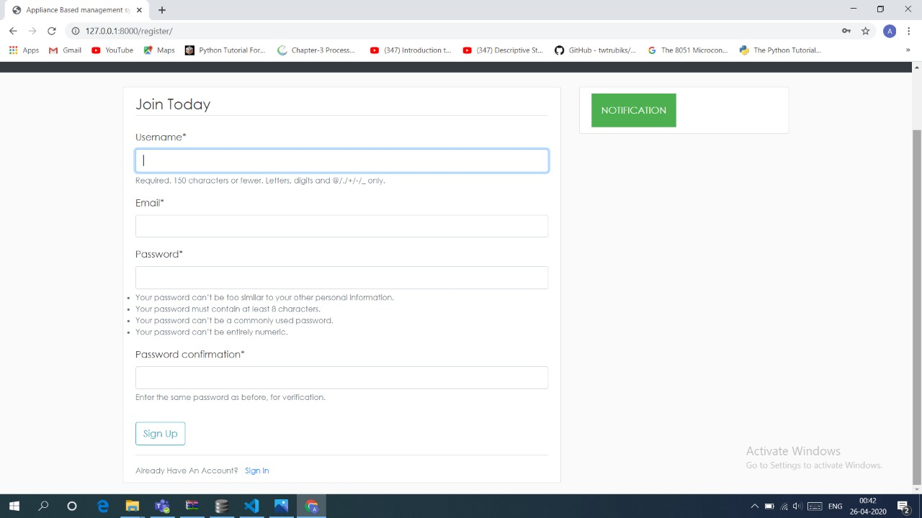
GUI SNAPSHOTS LOGIN LOGOUT SYSTEM

Slide 8
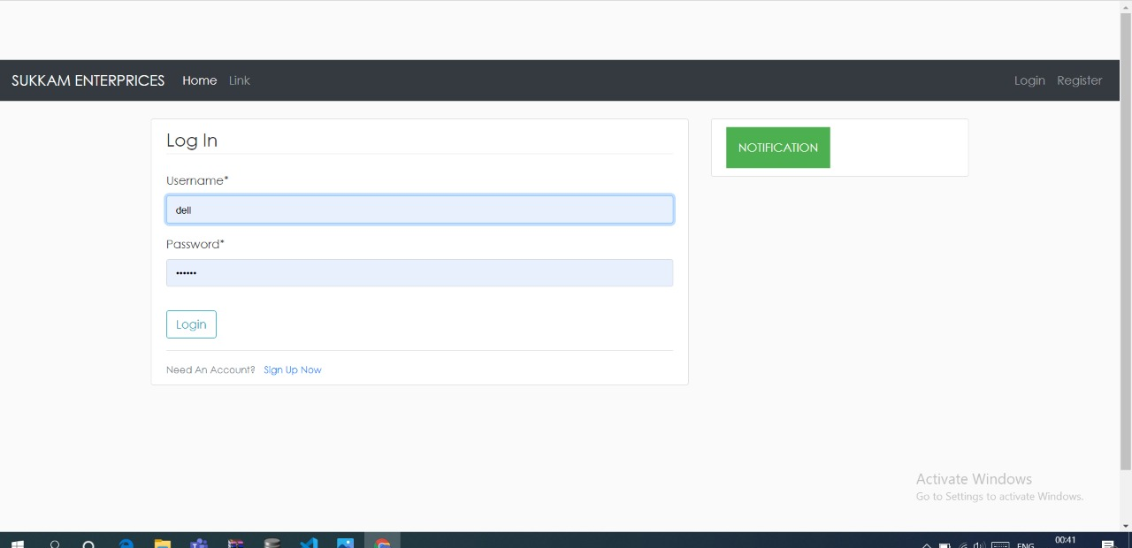
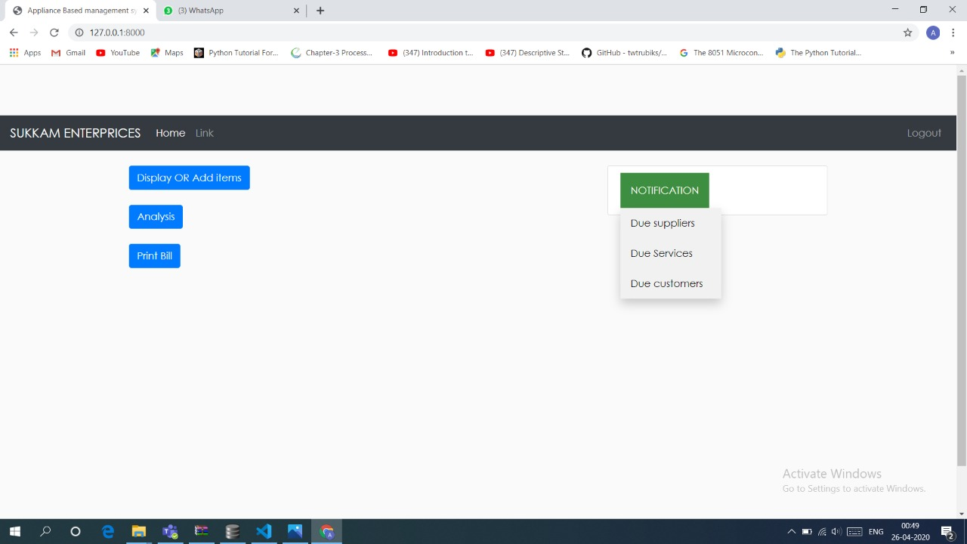
GUI SNAPSHOTS

Slide 9
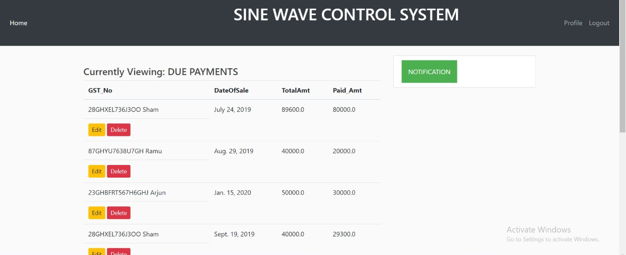
DUE SUPPLIER PAYMENTS

Slide 10
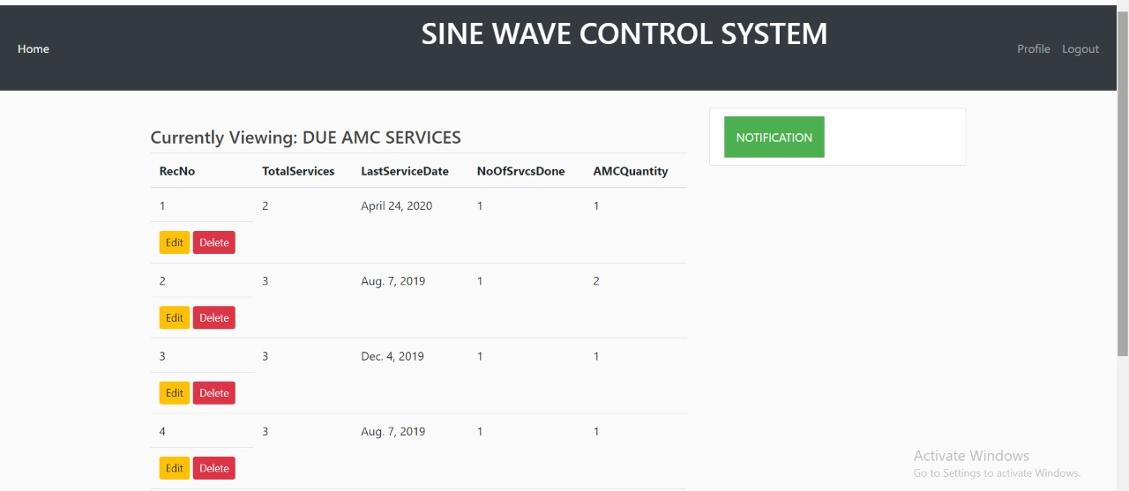
DUE AMC SERVICES

Slide 11
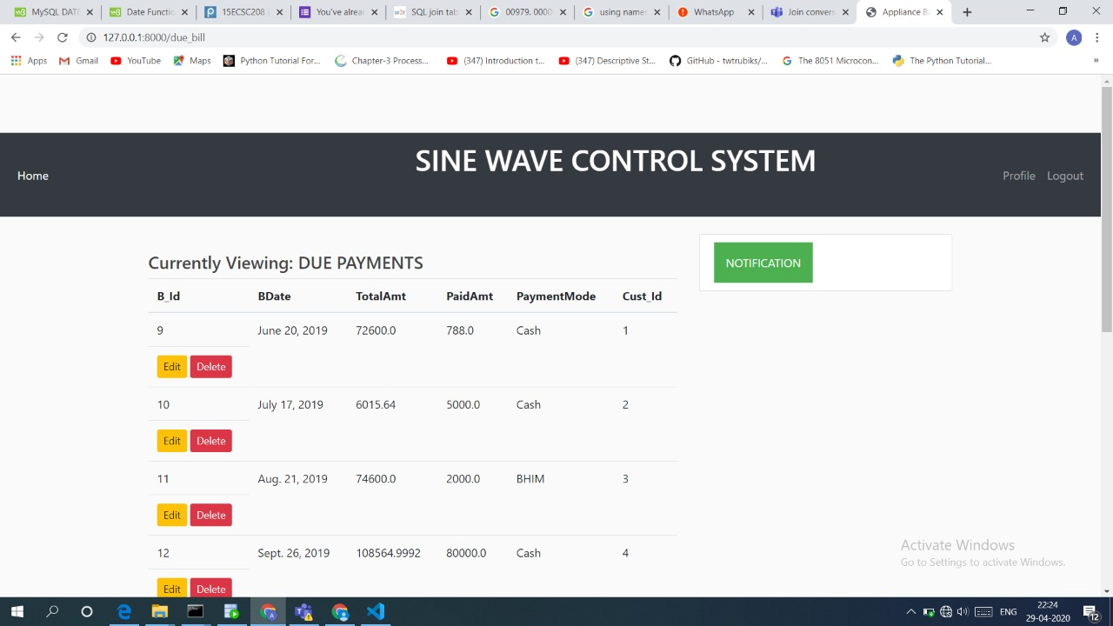
DUE CUSTOMER PAYMENTS

Slide 12
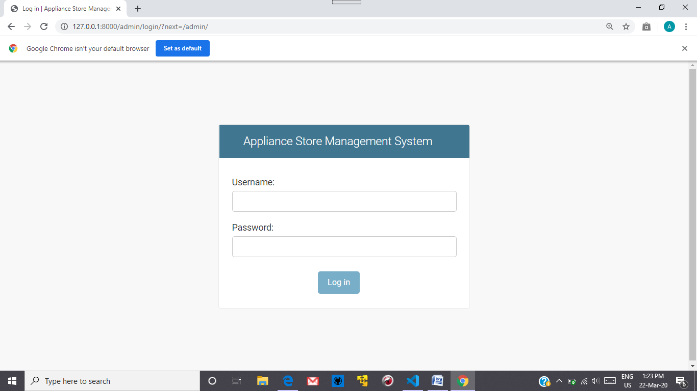
LOGIN AUTHENTICATION

Slide 13
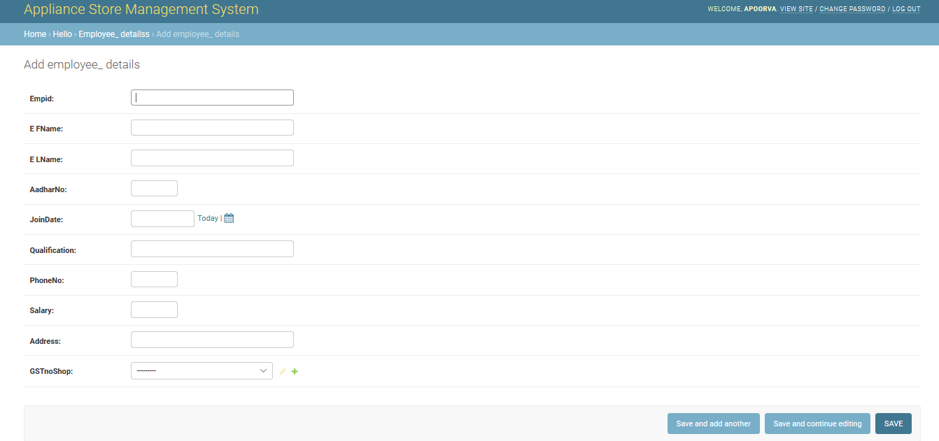
Employee Details

Slide 14
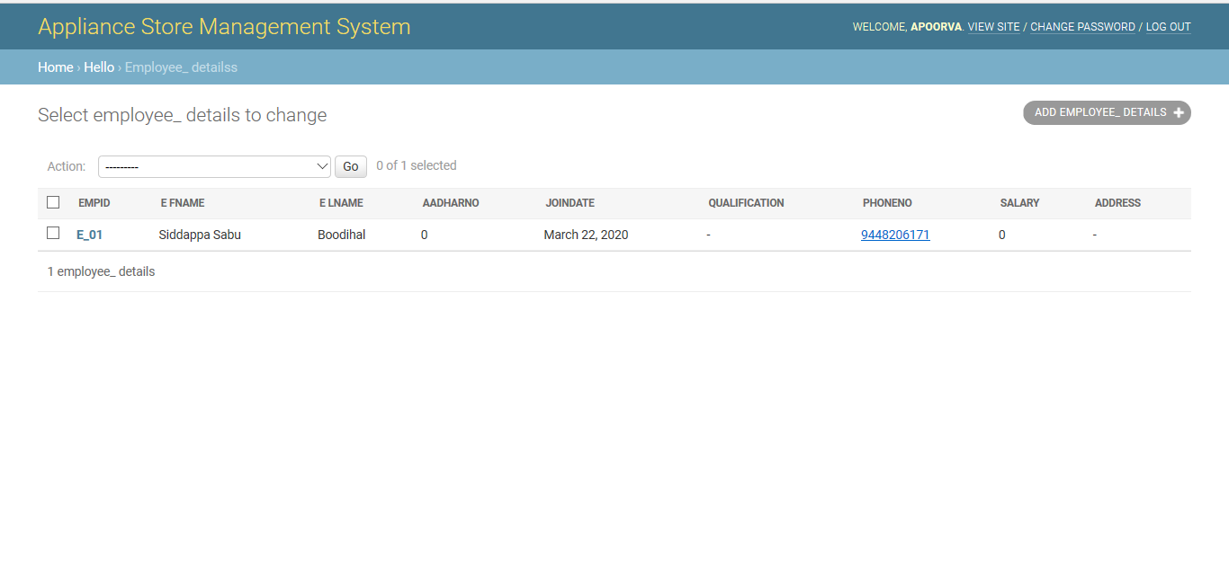

Slide 15
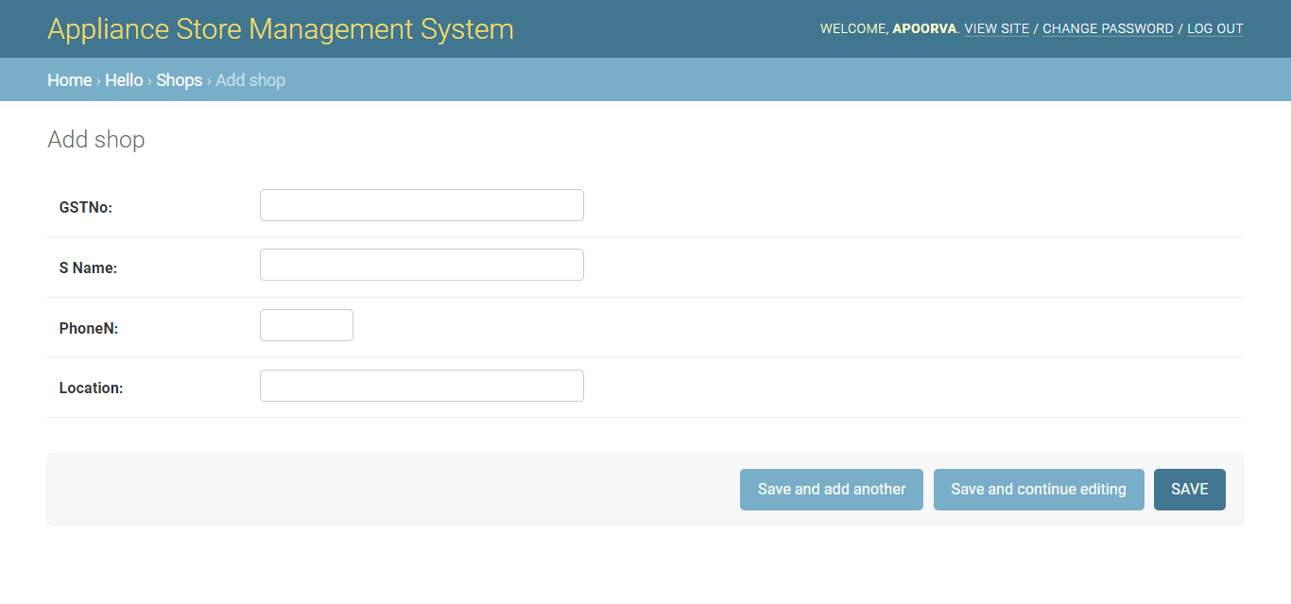
SHOP DETAILS

Slide 16
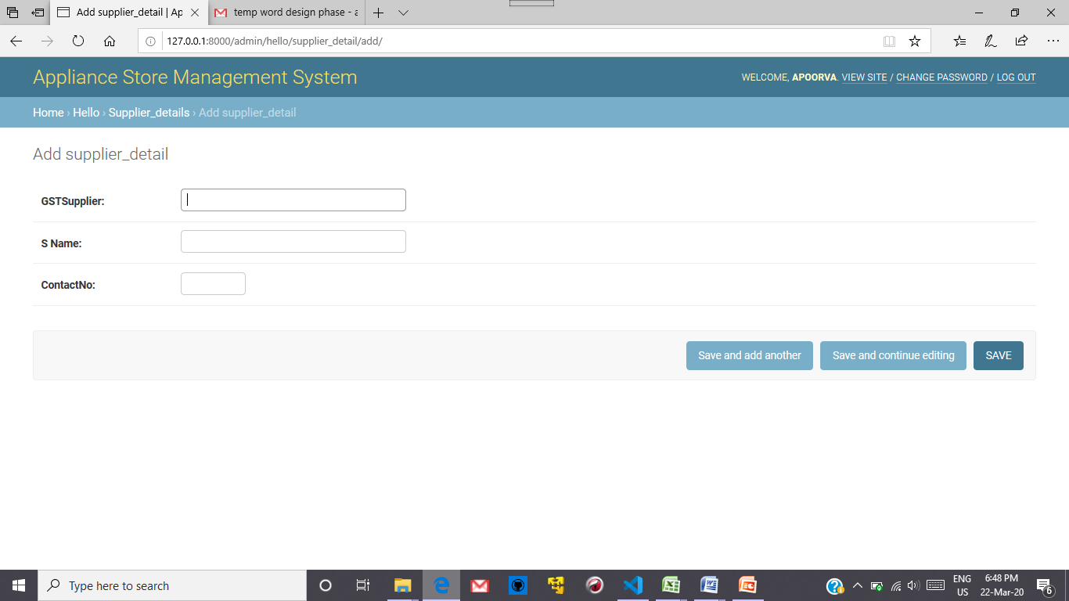
SUPPLIER DETAILS

Slide 17
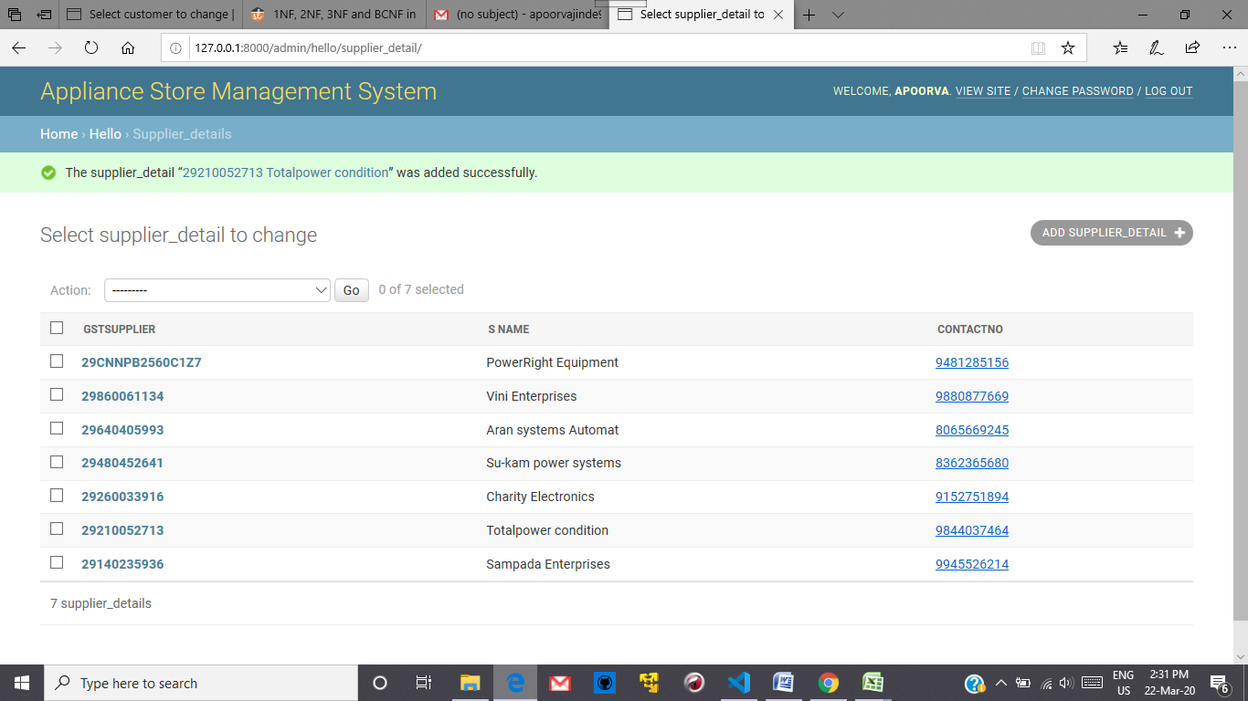
SUPPLIER ENTRIES

Slide 18
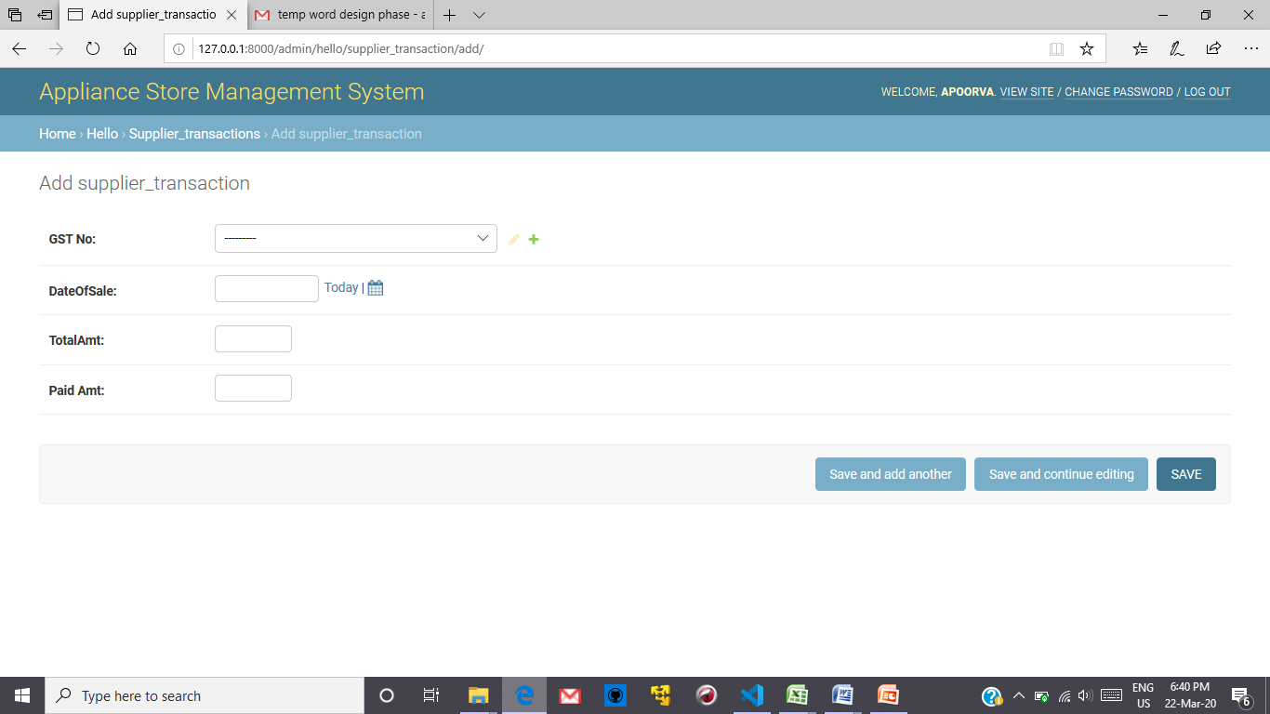
SUPPLIER_TRANSACTIONS

Slide 19
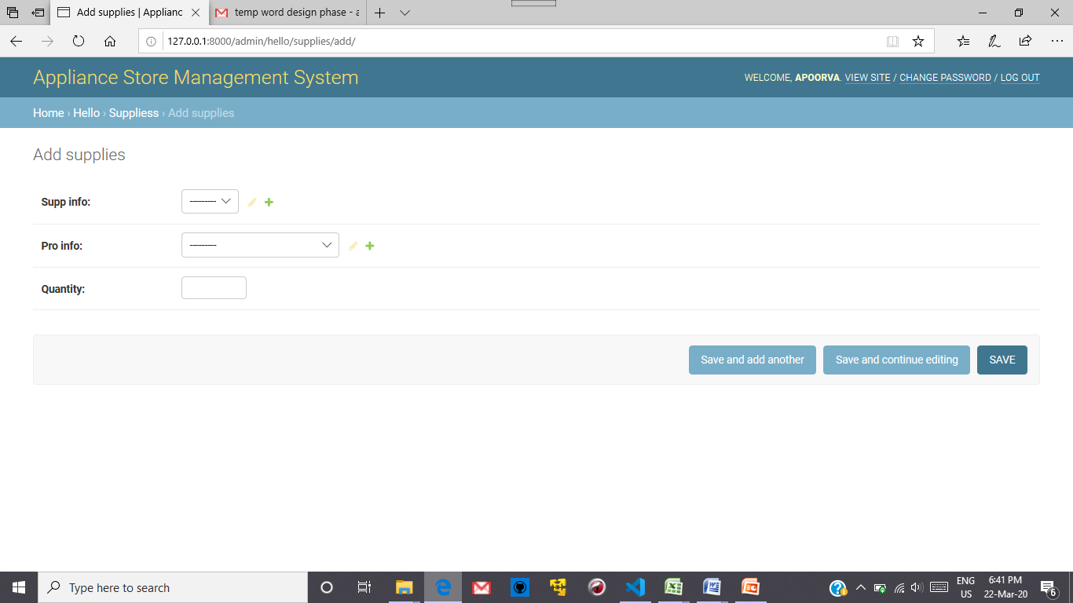
SUPPLIES TABLE

Slide 20
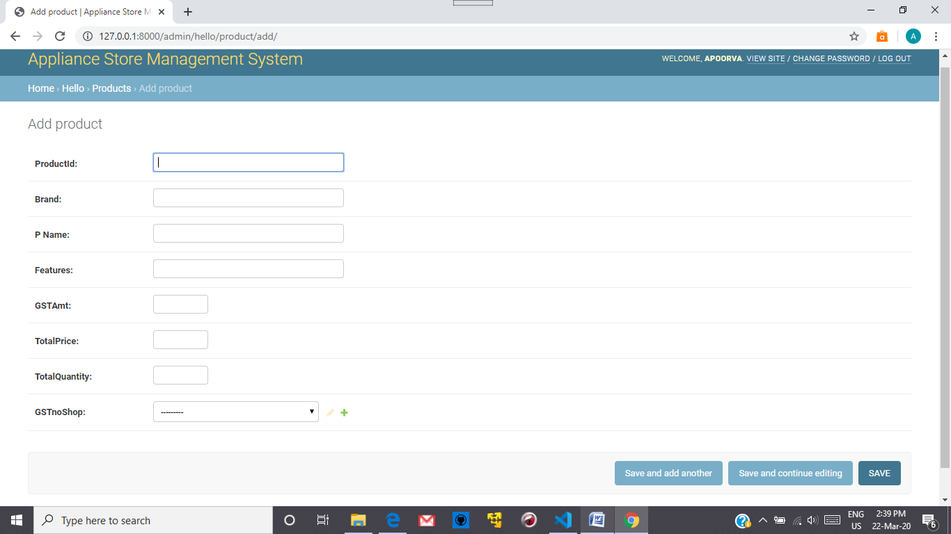
PRODUCT DETAILS

Slide 21
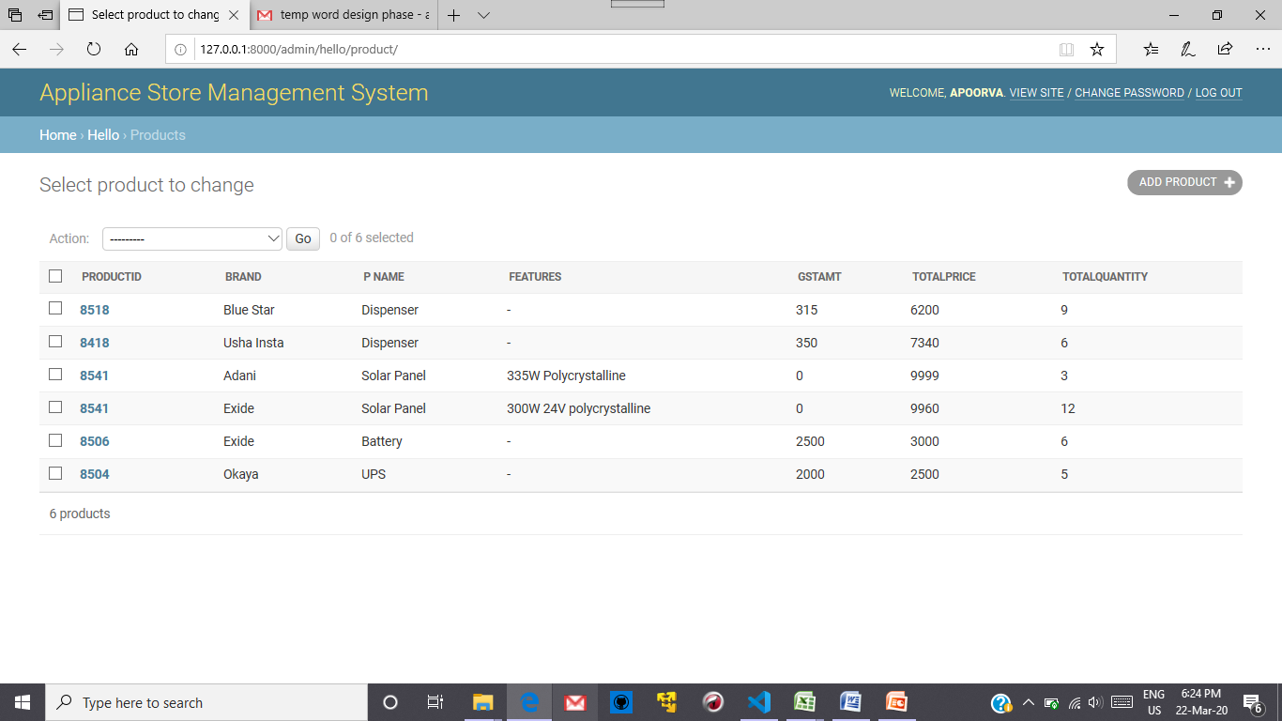
PRODUCT ENTRIES

Slide 22
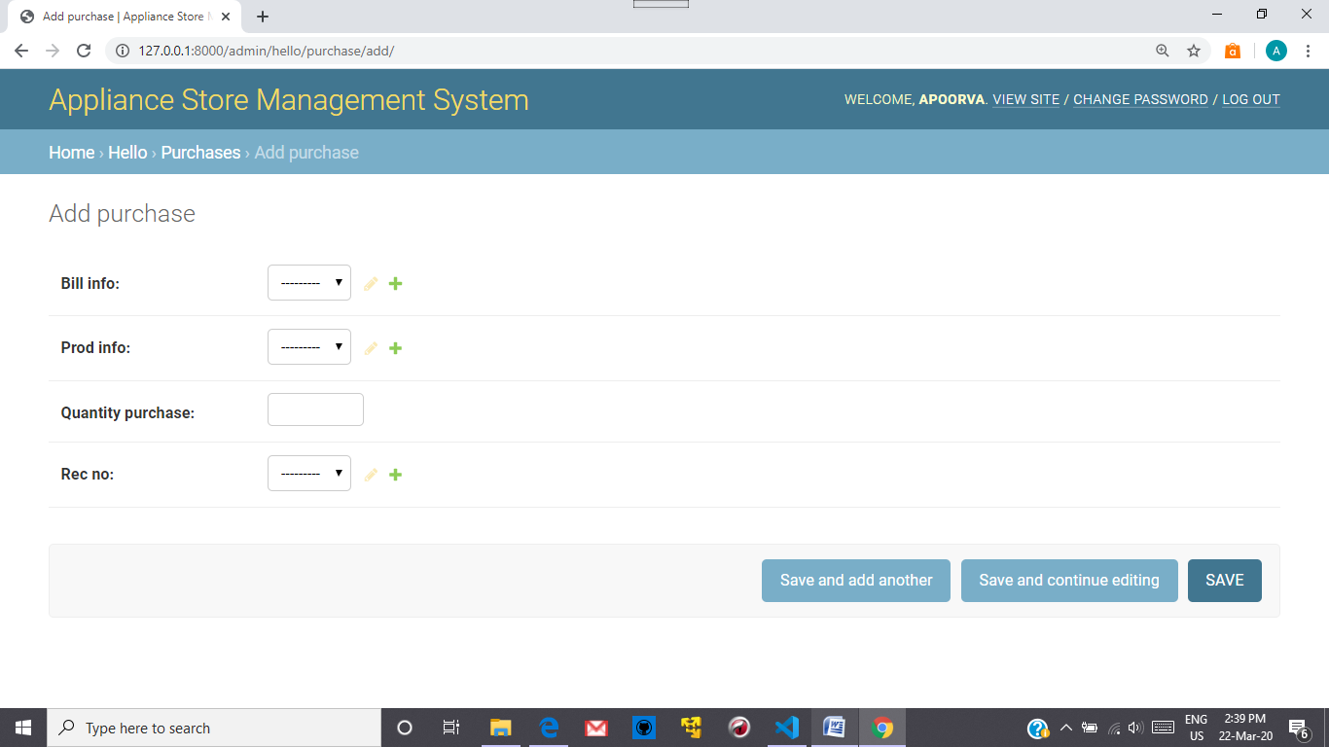
PURCHASE DETAILS

Slide 23
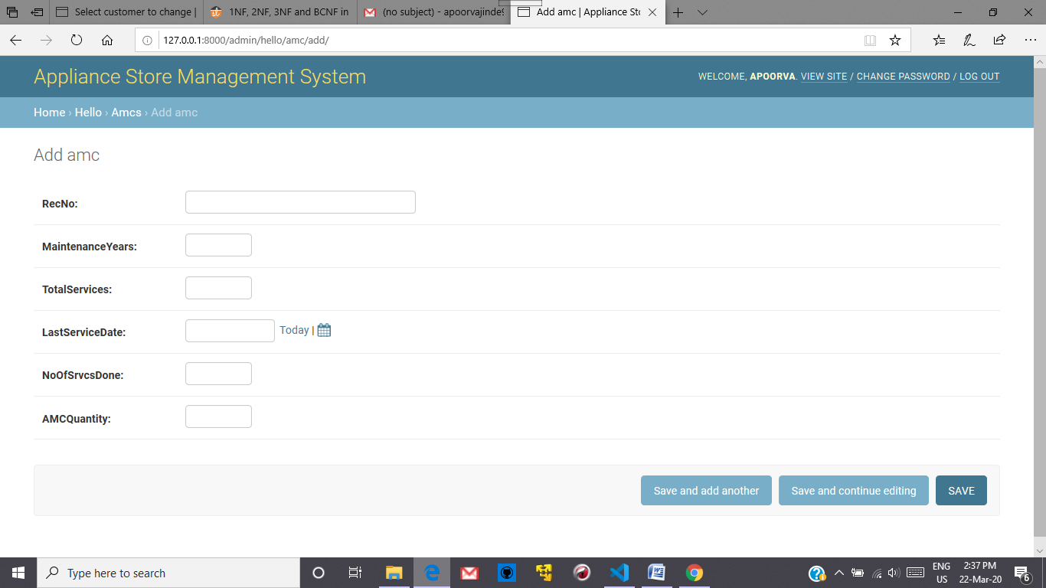
AMC DETAILS

Slide 24
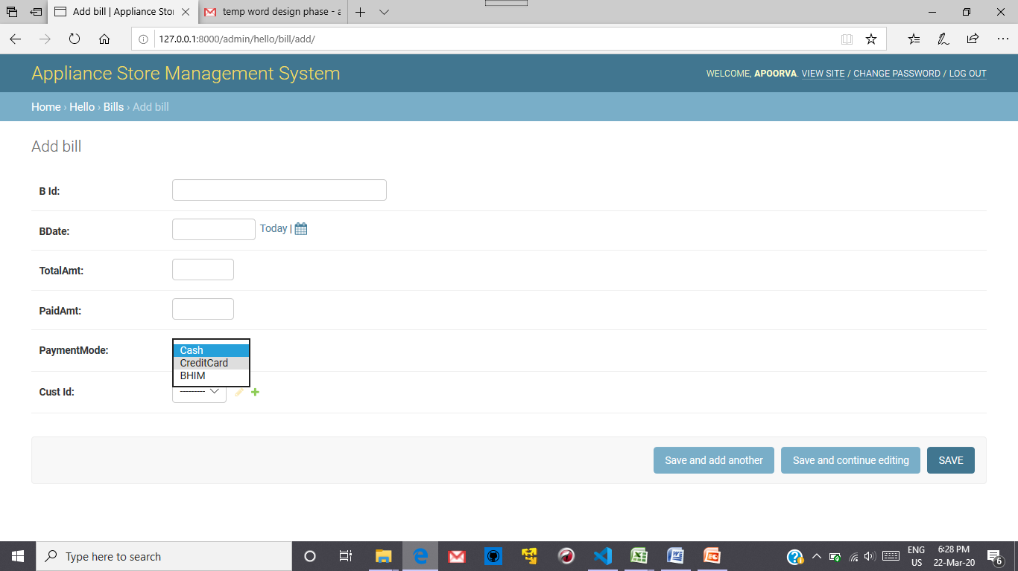
BILL DETAILS

Slide 25
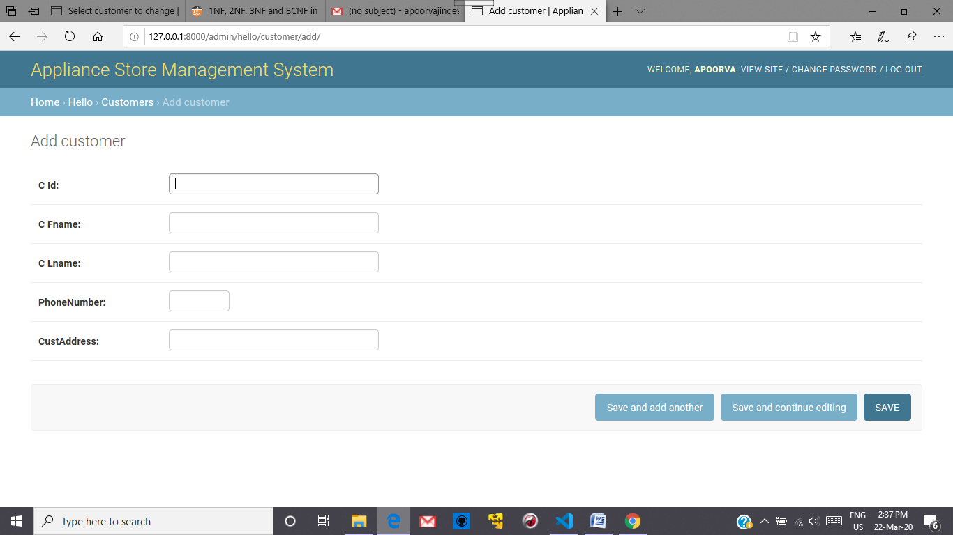
CUSTOMER DETAILS

Slide 26
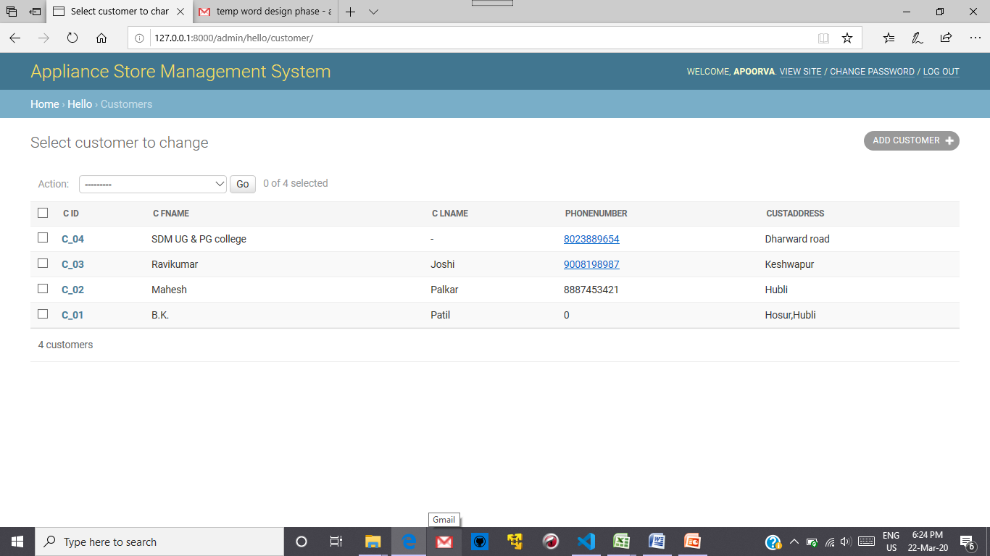

Slide 27


THANK YOU

